Slide 1
GLENDENNING PUBLIC SCHOOL
MEET THE TEACHER
YEAR 6, 2021
Notes:
Kirsten
Welcome. general information - parents who wish to discuss individual students learning progress please make an appointment via our office to see CRTs
Remind - sign on sheet, QR codes - SIP

Slide 2
STAFF OVERVIEW
LEADERSHIP TEAM
Principal - Mr Doug Meaney
Deputy Principal - Miss Kathy Rox
Assistant Principal K/1 - Mrs Tamiko Gleeson
Assistant Principal Year 2 - Ms Angelina Nguyen
Assistant Principal Years 3/4 - Mr Paul Keyes
Assistant Principal Years 5/6 - Miss Kirsten Milledge
YEAR 1
Notes:
Kirsten

Slide 3
TEAM OVERVIEW
YEAR 6
Team Leader - Miss Kirsten Milledge
6S - Miss Jordan Spencer
6I - Miss Viviane Nguyen
5/6L - Miss Lauren Leckie
YEAR 1
Notes:
Kirsten

Slide 4
GROWING AND LEARNING TOGETHER
Student
Teacher
Parent
Notes:
Kirsten
PARTNERSHIP

Slide 5
CONTACT DETAILS
In case of an emergency, it is essential that all contact details are up-to-date.
These include:
Contact numbers - mobile, home and work
Emergency contact details
Custody information
Medical details
Notes:
Lauren

Slide 6
LINES OF COMMUNICATION
If you have any issues of concerns, please contact the following people in this order:
Classroom Teacher
Grade Team Leader
Principal
Office Hours: Monday to Friday 8.30 am - 3.15 pm
YEAR 1
Notes:
Lauren - information about what you want to discuss. Be aware that it might take the teacher

Slide 7
SCHOOL TIMES
8.30 am Playground Supervision
9.00 am Morning Session
11.15 am Eating Time
11.30 am Lunch 1
11.50 am Lunch 2
12.10 pm Middle Session
1.40 pm Afternoon Tea
2.00 pm Afternoon Session
3.00 pm Dismissal
Notes:
Lauren - no active supervision before 8:30am - students are supervised. 9am school starts - if your child arrives after after the bell they must go to the office to get a late note. Remind lunch first then afternoon afterwards. Send things the students can open. 3pm dismissal - can dismiss from the back playground.

Slide 8
ATTENDANCE
It is very important that students attend school every day.
If absences are unavoidable (such as sickness, etc.), please ensure you send a note to explain the absence, or use the SkoolBag app, within 7 days of the absence.
Any absence over 10 days, needs an application for extended leave (available from the front office).
Notes:
Lauren - school bag app, call front office. Long absence apply through the front office. Effects of poor attendance. Teachers will ring in the afternoon to confirm the student’s absence. Recommend parents to contact the school in the morning to make this process easier. One week to bring a note back to justify their absence.

Slide 9
POSITIVE BEHAVIOURS FOR LEARNING (PBL)
Students at GPS are expected to be:
Safe
Respectful
Learners
Awards and Caught You Being Good Tokens are given regularly to promote these values.
Consequences apply for students who do not meet our school values.
Notes:
Jordan - stands for positive behaviour for learning. School values.
You will be notified through letters about 3 minors or major incidents.
We give a consequence at school and ask that you have chat with your child about their actions.

Slide 10
CURRICULUM OVERVIEW
English
Writing
Reading
Spelling
Handwriting
Grammar
Maths
Science and Technology
History/Geography
Personal Development, Health and Physical Education
Creative Arts
Homework
Notes:
Jordan
Writing Cycle
most time given to English and maths
Homework has been assigned on Google Classroom. Check the Google classroom if you are unsre or contact the class teacher.
Tech Hub
Bounce Back
Term overview

Slide 11
LIBRARY AND SPORT DAY
6S
Sport: Friday @ 10 am
Library: Tuesday
6I
Sport: Friday @ 10 am
Library: Monday
5/6L
Sport: Friday @ 10 am
Library: Monday
Notes:
Lauren

Slide 12
COMMUNICATION PLATFORMS
Weekly Newsletter - Thursday
Permission Notes - Thursday
Skoolbag App
Facebook
Instagram
Electronic Sign
Notes:
Kirsten

Slide 13
LEARNING RESOURCE PACKS
Each year, the school organises a supply of resources for students. We ask parents/caregivers to contribute $50 as a one-off donation. Once these items are paid for, parents are NOT expected to buy any items for use at school during the year as these are continually replaced. Standardisations of these resources ensure students receive the same resources for use in their classrooms. The Learning Resource Packs go directly to the classroom.
YEAR 1
Notes:
Jordan

Slide 14
UNIFORM
The Uniform Shop is located in the hall and is run by P&C volunteers. The usual hours are Monday 8.30 - 9 am and Friday 8.30 - 9.15 am.
Red polo shirt
Navy blue shorts/tracksuit pants
Navy blue check dress
Navy blue jacket
Senior jacket
Navy blue socks
Black shoes
Hat
Notes:
Jordan

Slide 15
HEALTH
ALLERGIES AND HEALTH CARE PLANS
An individual health care plan must always be developed in consultation with the Principal (nominee) and where appropriate, the family medical practitioner for:
severe asthma, type 1 diabetes, epilepsy and anaphylaxis;
any student who is diagnosed as being at risk of an emergency reaction;
any student who requires the administration of health care procedures.
YEAR 1
Notes:
Jordan

Slide 16
GRIFFIN CITIZENSHIP RECOGNITION AWARD
To develop confident, self-reliant, independent, positive learners with a sense of self-esteem and ability to make decisions and take responsibility of their lives and contributions to their community.
Notes:
Lauren

Slide 17
GRIFFIN CITIZENSHIP RECOGNITION AWARD
VALUES AND SETTINGS
Settings - home, school and community
1: Intrinsic Integrity Responsibility Respect | 2: Personal Excellence Cooperation Participation | 3: Civic Awareness Care Fairness Democracy
Notes:
Lauren

Slide 18
GRIFFIN CITIZENSHIP RECOGNITION AWARD
Demonstrate achievement of at least 1 value in each setting, in each group (total of 9 pieces of evidence). Evidence can be in the form of drawings, photos and written annotations.
Students will attend regular meetings with Miss Leckie at lunch time throughout each term to show their progress and receive feedback.
Students will participate in fundraising events and activities to support the school and their local community.
Students will present their portfolio at an interview with a panel that includes Mr Meaney, Miss Rox, Miss Leckie, Miss Milledge, a P&C representative and members of our SRC.
If students are successful, they will receive an award at presentation day.
WHAT IS INVOLVED:
Notes:
Lauren

Slide 19
GRIFFIN CITIZENSHIP RECOGNITION AWARD
Whether or not they are interested
This requires time and effort to complete - it is not something that can be done overnight
They must attend the required meetings with Miss Leckie to show their progress and adopt the feedback given to them
They need to participate in various activities to support the school and the Glendenning community
Complete the application and return to Miss Leckie by the Thursday 11 March, 2021.
DISCUSS THE FOLLOWING WITH YOUR CHILD:
IF YOUR CHILD IS INTERESTED
Notes:
Lauren

Slide 20
High School Forms
Next week, Yr 6 will be bringing home their High School Expression of Interest form for 2022.
Each form includes your child’s local high school based on their CURRENT RESIDENTIAL ADDRESS.
All forms need to be returned to your child’s classroom teacher no later than Friday 19 March, 2021.
Every child MUST return a form.

Slide 21
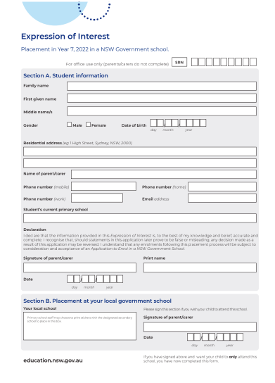
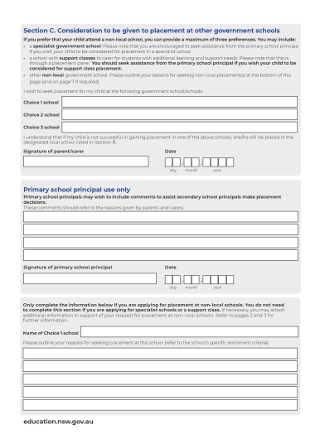
Section C - If you wish for your child to attend another government school. Please ensure you list them here.
You also need to outline the reasons why you are seeking placement at this school.
Section A MUST BE FILLED OUT
Section B - Only sign if you would like your child to attend the local High School indicated. Please don’t cross this out.

Slide 22
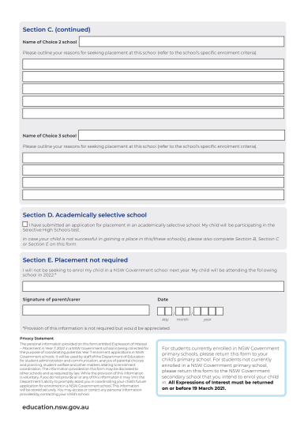
Section D - tick this box if you have submitted an application for a selective school. Please ensure you also fill out Section B, C or E.
Section E - Fill and sign this section if your child is attending a non-government High School in 2022.

Slide 23
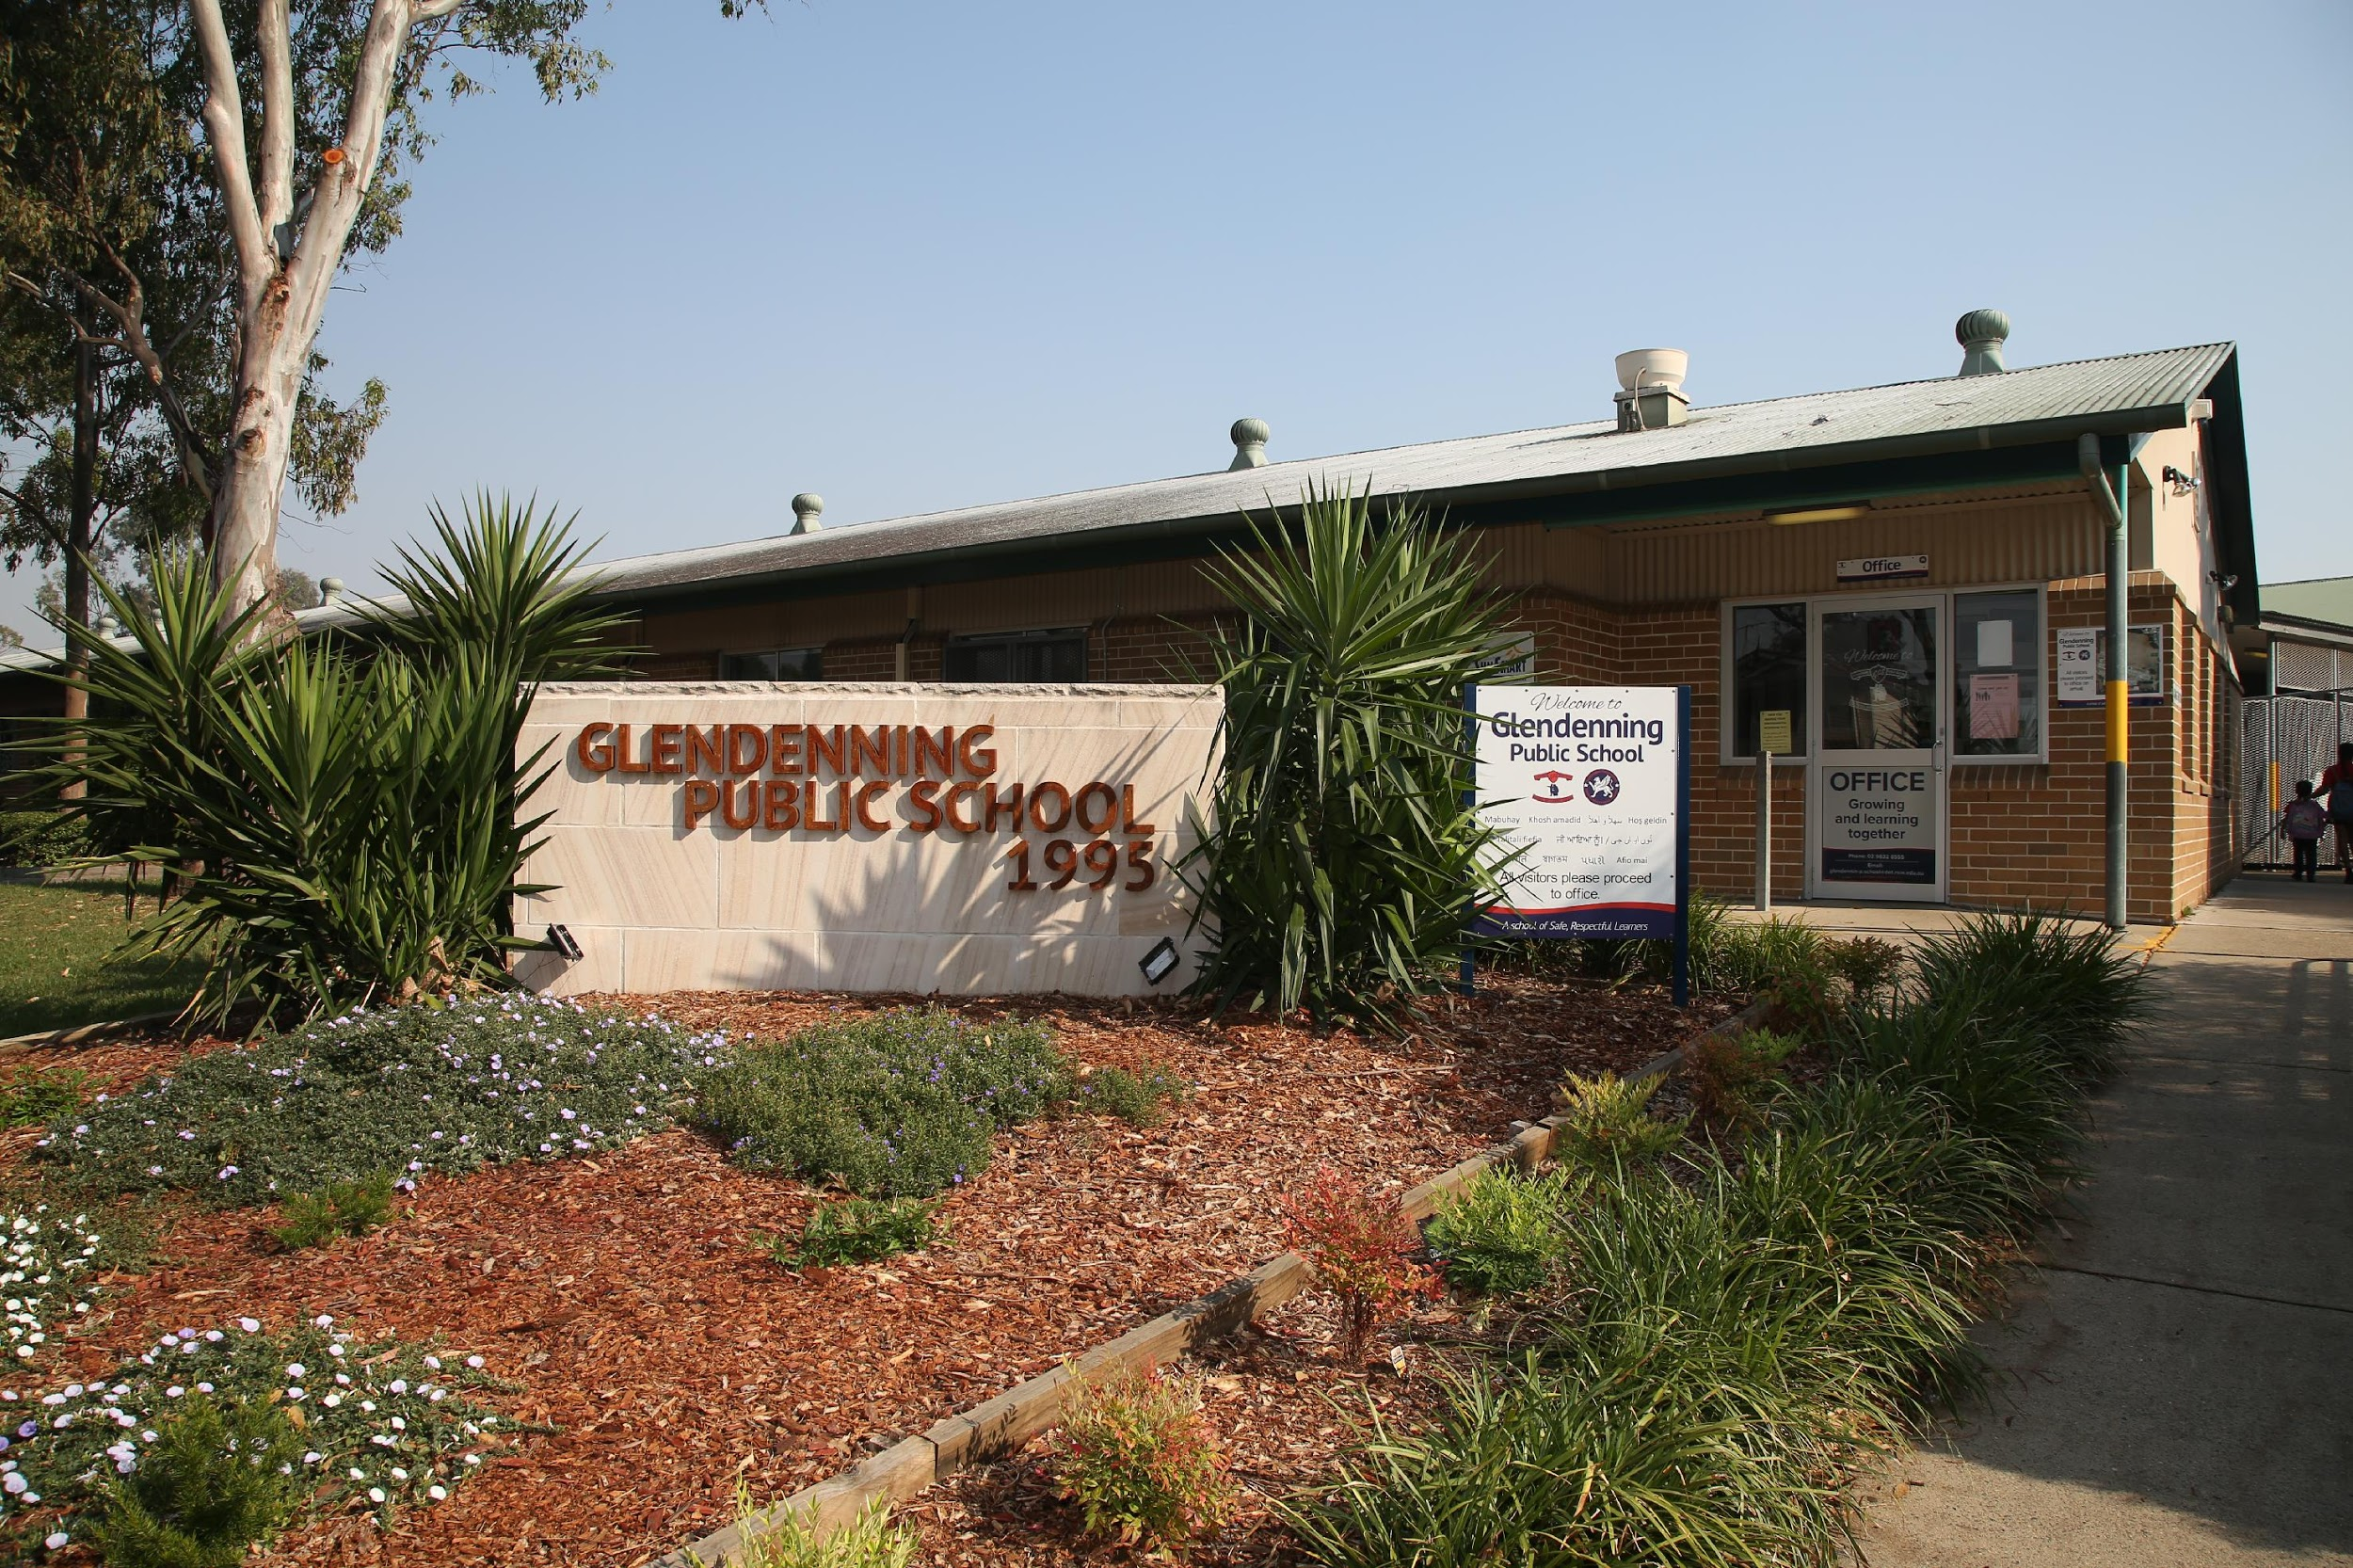
THANK YOU!
Please contact the office if you would like to speak to your child’s classroom teacher:
9832 8555 or via the school email address.
Notes:
Kirsten

