Slide 1
GLENDENNING PUBLIC SCHOOL
MEET THE TEACHER
YEAR 5, 2021
Notes:
Kirsten

Slide 2
STAFF OVERVIEW
LEADERSHIP TEAM
Principal - Mr Doug Meaney
Deputy Principal - Miss Kathy Rox
Assistant Principal K/1 - Mrs Tamiko Gleeson
Assistant Principal Year 2 - Ms Angelina Nguyen
Assistant Principal Years 3/4 - Mr Paul Keyes
Assistant Principal Years 5/6 - Miss Kirsten Milledge
YEAR 1
Notes:
Kirsten

Slide 3
TEAM OVERVIEW
YEAR 5
Team Leader - Miss Kirsten Milledge
3/4/5D - Miss Clare Donovan
5E - Mr David Ellacott
5K - Miss Mirjana Krivacic
5/6L - Miss Lauren Leckie
YEAR 1
Notes:
Kirsten

Slide 4
GROWING AND LEARNING TOGETHER
Student
Teacher
Parent
Notes:
Kirsten
PARTNERSHIP

Slide 5
CONTACT DETAILS
In case of an emergency, it is essential that all contact details are up-to-date.
These include:
Contact numbers - mobile, home and work
Emergency contact details
Custody information
Medical details
Notes:
Mirjana
The school has a duty of care for all children attending Glendenning Public School.
In case of an emergency, it is essential that all contact details are up to date. This includes all phone numbers, such as mobile, home and work. Including emergency contact details in case the school is unable to contact parents directly.
If you have recently changed address, please contact the school and forward recent information.
Updating contact information is very important because if the school is unable to make contact and an emergency occurs the school will ring an ambulance ASAP.
Custodial information and medical details are of importance. The school and teachers have a duty to protect your child from risks or harm, therefore if your child has a custodial information or medical condition, please update these records immediately and without hesitation.

Slide 6
LINES OF COMMUNICATION
If you have any issues of concerns, please contact the following people in this order:
Classroom Teacher
Grade Team Leader
Principal
Office Hours: Monday to Friday 8.30 am - 3.15 pm
YEAR 1
Notes:
Mirjana
Communicating with teachers is very important. The office is open between the hours of 8.30am to 3.15pm. It is advisable to telephone the school between those hours or alternatively send an email.
Unfortunately, teachers are on class between those hours and are unable to take your call. However, if you leave a short message the teacher will get back to you in a day or 2. Teachers do understand the importance of your call and will contact you after 3.15pm.
Your 1st point of contact is the classroom teacher. If you have
The teacher will notify Miss Millage and notify her of your concerns. She will
If you have changed phone numbers or any details, please contact the office staff and they will be happy to update the records.

Slide 7
SCHOOL TIMES
8.30 am Playground Supervision
9.00 am Morning Session
11.15 am Eating Time
11.30 am Lunch 1
11.50 am Lunch 2
12.10 pm Middle Session
1.40 pm Afternoon Tea
2.00 pm Afternoon Session
3.00 pm Dismissal
Notes:
Mirjana
Teachers start arriving at school at 8.30am. It is important to know that if your child arrives before 8.30am there will be no supervision. Children are asked to sit on the library stairs and wait for a teacher to arrive.
School starts at 9.00am sharp. Any child arriving late must go straight to the office and get a late note.
Between the hours of 9.00 and 11.15 children are engaging in learning activities.
All students are given 15 min eating time each day in the classroom or outside in the shade.
Lunch begins and 11.30am to 12.10pm. It is important your child can open all containers and food packaging.
between the hours of 12.10 to 1.40 children are engaged in learning activities.
Afternoon tea is a short break of 20min to have a snack and socialise with friends.
School ends at 3pm and children can be picked up via the front or back gates.

Slide 8
ATTENDANCE
It is very important that students attend school every day.
If absences are unavoidable (such as sickness, etc.), please ensure you send a note to explain the absence, or use the SkoolBag app, within 7 days of the absence.
Any absence over 10 days, needs an application for extended leave (available from the front office).
Notes:
Mirjana
Attending school is of most importance because your child will make friends, participate in learning activities and develop mentally, socially, emotionally, physically and academically.
Notify the school in the morning if your child absence by the School Bag app, telephoning the school directly or if you are aware your child will be absent due to an appointment you could contact the teacher or send a note prior to explain their abcence. An absence over 10 days requires an application for extended leave and is available at the front office.
The teacher will contact all parents during the afternoon if your child is absent without an explanation.
It is important to provide an explanation why your child has missed school either verbally or a signed short note.
Perfect attendance is rewarded.
Recommend parents to contact the school in the morning to make this process easier. One week to bring a note back to justify their absence.

Slide 9
POSITIVE BEHAVIOURS FOR LEARNING (PBL)
Students at GPS are expected to be:
Safe
Respectful
Learners
Awards and Caught You Being Good Tokens are given regularly to promote these values.
Consequences apply for students who do not meet our school values.
Notes:
David
At GPS we are a PBL school which instill the values of being Safe Respectful Learners in students. Students are rewarded for positive behaviour and are given consequences for negative behaviour. There is a clear school policy that we follow as a school when students display negative behaviours.This program focuses on ensuring that students behaviour is focussed on approaching all aspects of their school life in a positive manner.

Slide 10
CURRICULUM OVERVIEW
English
Writing
Reading
Spelling
Handwriting
Grammar
Maths
Science and Technology
History/Geography
Personal Development, Health and Physical Education
Creative Arts
Homework
Notes:
David

Slide 11
LIBRARY AND SPORT DAY
5K
Sport: Friday @ 9.15 am
Library: Friday
5E
Sport: Friday @ 9.15 am
Library: Monday
5/6L
Sport: Friday @ 10 am
Library: Monday
3/4/5D
Sport: Tuesday @ 10 am
Library: Tuesday
Notes:
Mirjana
5K has sport at 9.15am and library on Fridays.
5E has sport with 5K at 9.15am on Fridays and library on Mondays.
5/6L has sport on Fridays at 10.00am and library on Mondays.
3/4/5D has sport on Tuesdays at 10.00am and library on Tuesday.
Your child should wear their sports uniform and appropriate shoes for sport.
Library bags are essential when borrowing books to take home. If you child borrows a book without a library bag the book will remain at the school until a bag is provided.

Slide 12
COMMUNICATION PLATFORMS
Weekly Newsletter - Thursday
Permission Notes - Thursday
Skoolbag App
Facebook
Instagram
Electronic Sign
Notes:
Kirsten

Slide 13
LEARNING RESOURCE PACKS
Each year, the school organises a supply of resources for students. We ask parents/caregivers to contribute $50 as a one-off donation. Once these items are paid for, parents are NOT expected to buy any items for use at school during the year as these are continually replaced. Standardisations of these resources ensure students receive the same resources for use in their classrooms. The Learning Resource Packs go directly to the classroom.
YEAR 1
Notes:
David

Slide 14
UNIFORM
The Uniform Shop is located in the hall and is run by P&C volunteers. The usual hours are Monday 8.30 - 9 am and Friday 8.30 - 9.15 am.
Red polo shirt
Navy blue shorts/tracksuit pants
Navy blue check dress
Navy blue jacket
Senior jacket
Navy blue socks
Black shoes
Hat
Notes:
David

Slide 15
HEALTH
ALLERGIES AND HEALTH CARE PLANS
An individual health care plan must always be developed in consultation with the Principal (nominee) and where appropriate, the family medical practitioner for:
severe asthma, type 1 diabetes, epilepsy and anaphylaxis;
any student who is diagnosed as being at risk of an emergency reaction;
any student who requires the administration of health care procedures.
YEAR 1
Notes:
David

Slide 16
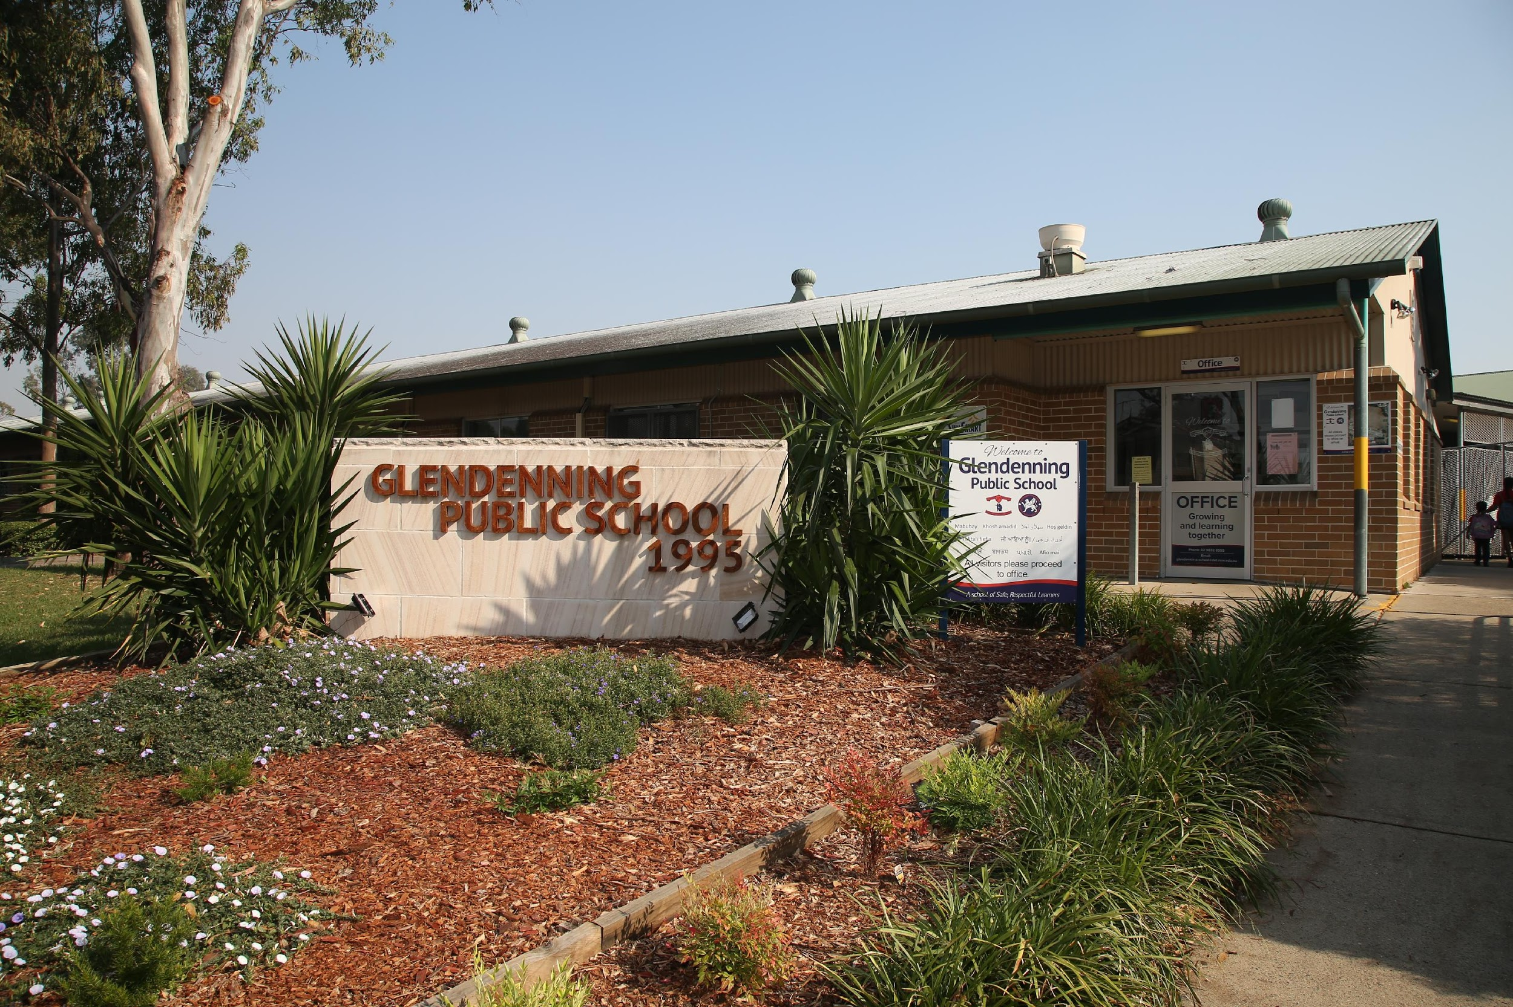
THANK YOU!
Please contact the office if you would like to speak to your child’s classroom teacher:
9832 8555 or via the school email address.
Notes:
Kirsten

