Slide 1
GLENDENNING PUBLIC SCHOOL
MEET THE TEACHER
KINDERGARTEN, 2021
Notes:
tamiko

Slide 2
STAFF OVERVIEW
LEADERSHIP TEAM
Principal - Mr Doug Meaney
Deputy Principal - Miss Kathy Rox
Assistant Principal K/1 - Mrs Tamiko Gleeson
Assistant Principal Year 2 - Ms Angelina Nguyen
Assistant Principal Years 3/4 - Mr Paul Keyes
Assistant Principal Years 5/6 - Miss Kirsten Milledge
YEAR 1
Notes:
tamiko

Slide 3
TEAM OVERVIEW
KINDERGARTEN
Team Leader - Mrs Tamiko Gleeson
KB - Miss Brenda Borg
KJ - Mrs Taylah Jones
KF - Miss Janaya Flood
YEAR 1
Notes:
tamiko

Slide 4
GROWING AND LEARNING TOGETHER
Student
Teacher
Parent
Notes:
PARTNERSHIP
Brenda

Slide 5
CONTACT DETAILS
In case of an emergency, it is essential that all contact details are up-to-date.
These include:
Contact numbers - mobile, home and work
Emergency contact details
Custody information
Medical details
Notes:
brenda

Slide 6
LINES OF COMMUNICATION
If you have any issues of concerns, please contact the following people in this order:
Classroom Teacher
Grade Team Leader
Principal
Office Hours: Monday to Friday 8.30 am - 3.15 pm
YEAR 1
Notes:
brenda

Slide 7
SCHOOL TIMES
8.30 am Playground Supervision
9.00 am Morning Session
11.15 am Eating Time
11.30 am Lunch 1
11.50 am Lunch 2
12.10 pm Middle Session
1.40 pm Afternoon Tea
2.00 pm Afternoon Session
2.50 pm Dismissal
Notes:
brenda

Slide 8
ATTENDANCE
It is very important that students attend school every day.
If absences are unavoidable (such as sickness, etc.), please ensure you send a note to explain the absence, or use the SkoolBag app, as soon as possible when students return to school.
Any absence over 10 days, needs an application for extended leave (available from the front office).
Notes:
taylah

Slide 9
POSITIVE BEHAVIOURS FOR LEARNING (PBL)
Students at GPS are expected to be:
Safe
Respectful
Learners
Awards and Caught You Being Good Tokens are given regularly to promote these values.
Consequences apply for students who do not meet our school values.
Notes:
taylah

Slide 10
CURRICULUM OVERVIEW
English
Writing
Reading
Spelling
Handwriting
Grammar
Maths
Science and Technology
History/Geography
Personal Development, Health and Physical Education
Creative Arts
Homework
Notes:
taylah

Slide 11
LIBRARY AND SPORT DAY
KB
Sport: Monday
Library: Friday
KJ
Sport: Monday
Library: Friday
KF
Sport: Monday
Library: Thursday
Notes:
taylah

Slide 12
COMMUNICATION PLATFORMS
Weekly Newsletter - Thursday
Permission Notes - Thursday
Skoolbag App
Facebook
Instagram
Electronic Sign
Notes:
janaya

Slide 13
LEARNING RESOURCE PACKS
Each year, the school organises a supply of resources for students. We ask parents/caregivers to contribute $50 as a one-off donation. Once these items are paid for, parents are NOT expected to buy any items for use at school during the year as these are continually replaced. Standardisations of these resources ensure students receive the same resources for use in their classrooms. The Learning Resource Packs go directly to the classroom.
YEAR 1
Notes:
janaya

Slide 14
UNIFORM
The Uniform Shop is located in the hall and is run by P&C volunteers. The usual hours are Monday 8.30 - 9 am and Friday 8.30 - 9.15 am.
Red polo shirt
Navy blue shorts/tracksuit pants
Navy blue check dress
Navy blue jacket
Senior jacket
Navy blue socks
Black shoes
Hat
Notes:
janaya

Slide 15
HEALTH
ALLERGIES AND HEALTH CARE PLANS
An individual health care plan must always be developed in consultation with the Principal (nominee) and where appropriate, the family medical practitioner for:
severe asthma, type 1 diabetes, epilepsy and anaphylaxis;
any student who is diagnosed as being at risk of an emergency reaction;
any student who requires the administration of health care procedures.
YEAR 1
Notes:
janaya

Slide 16
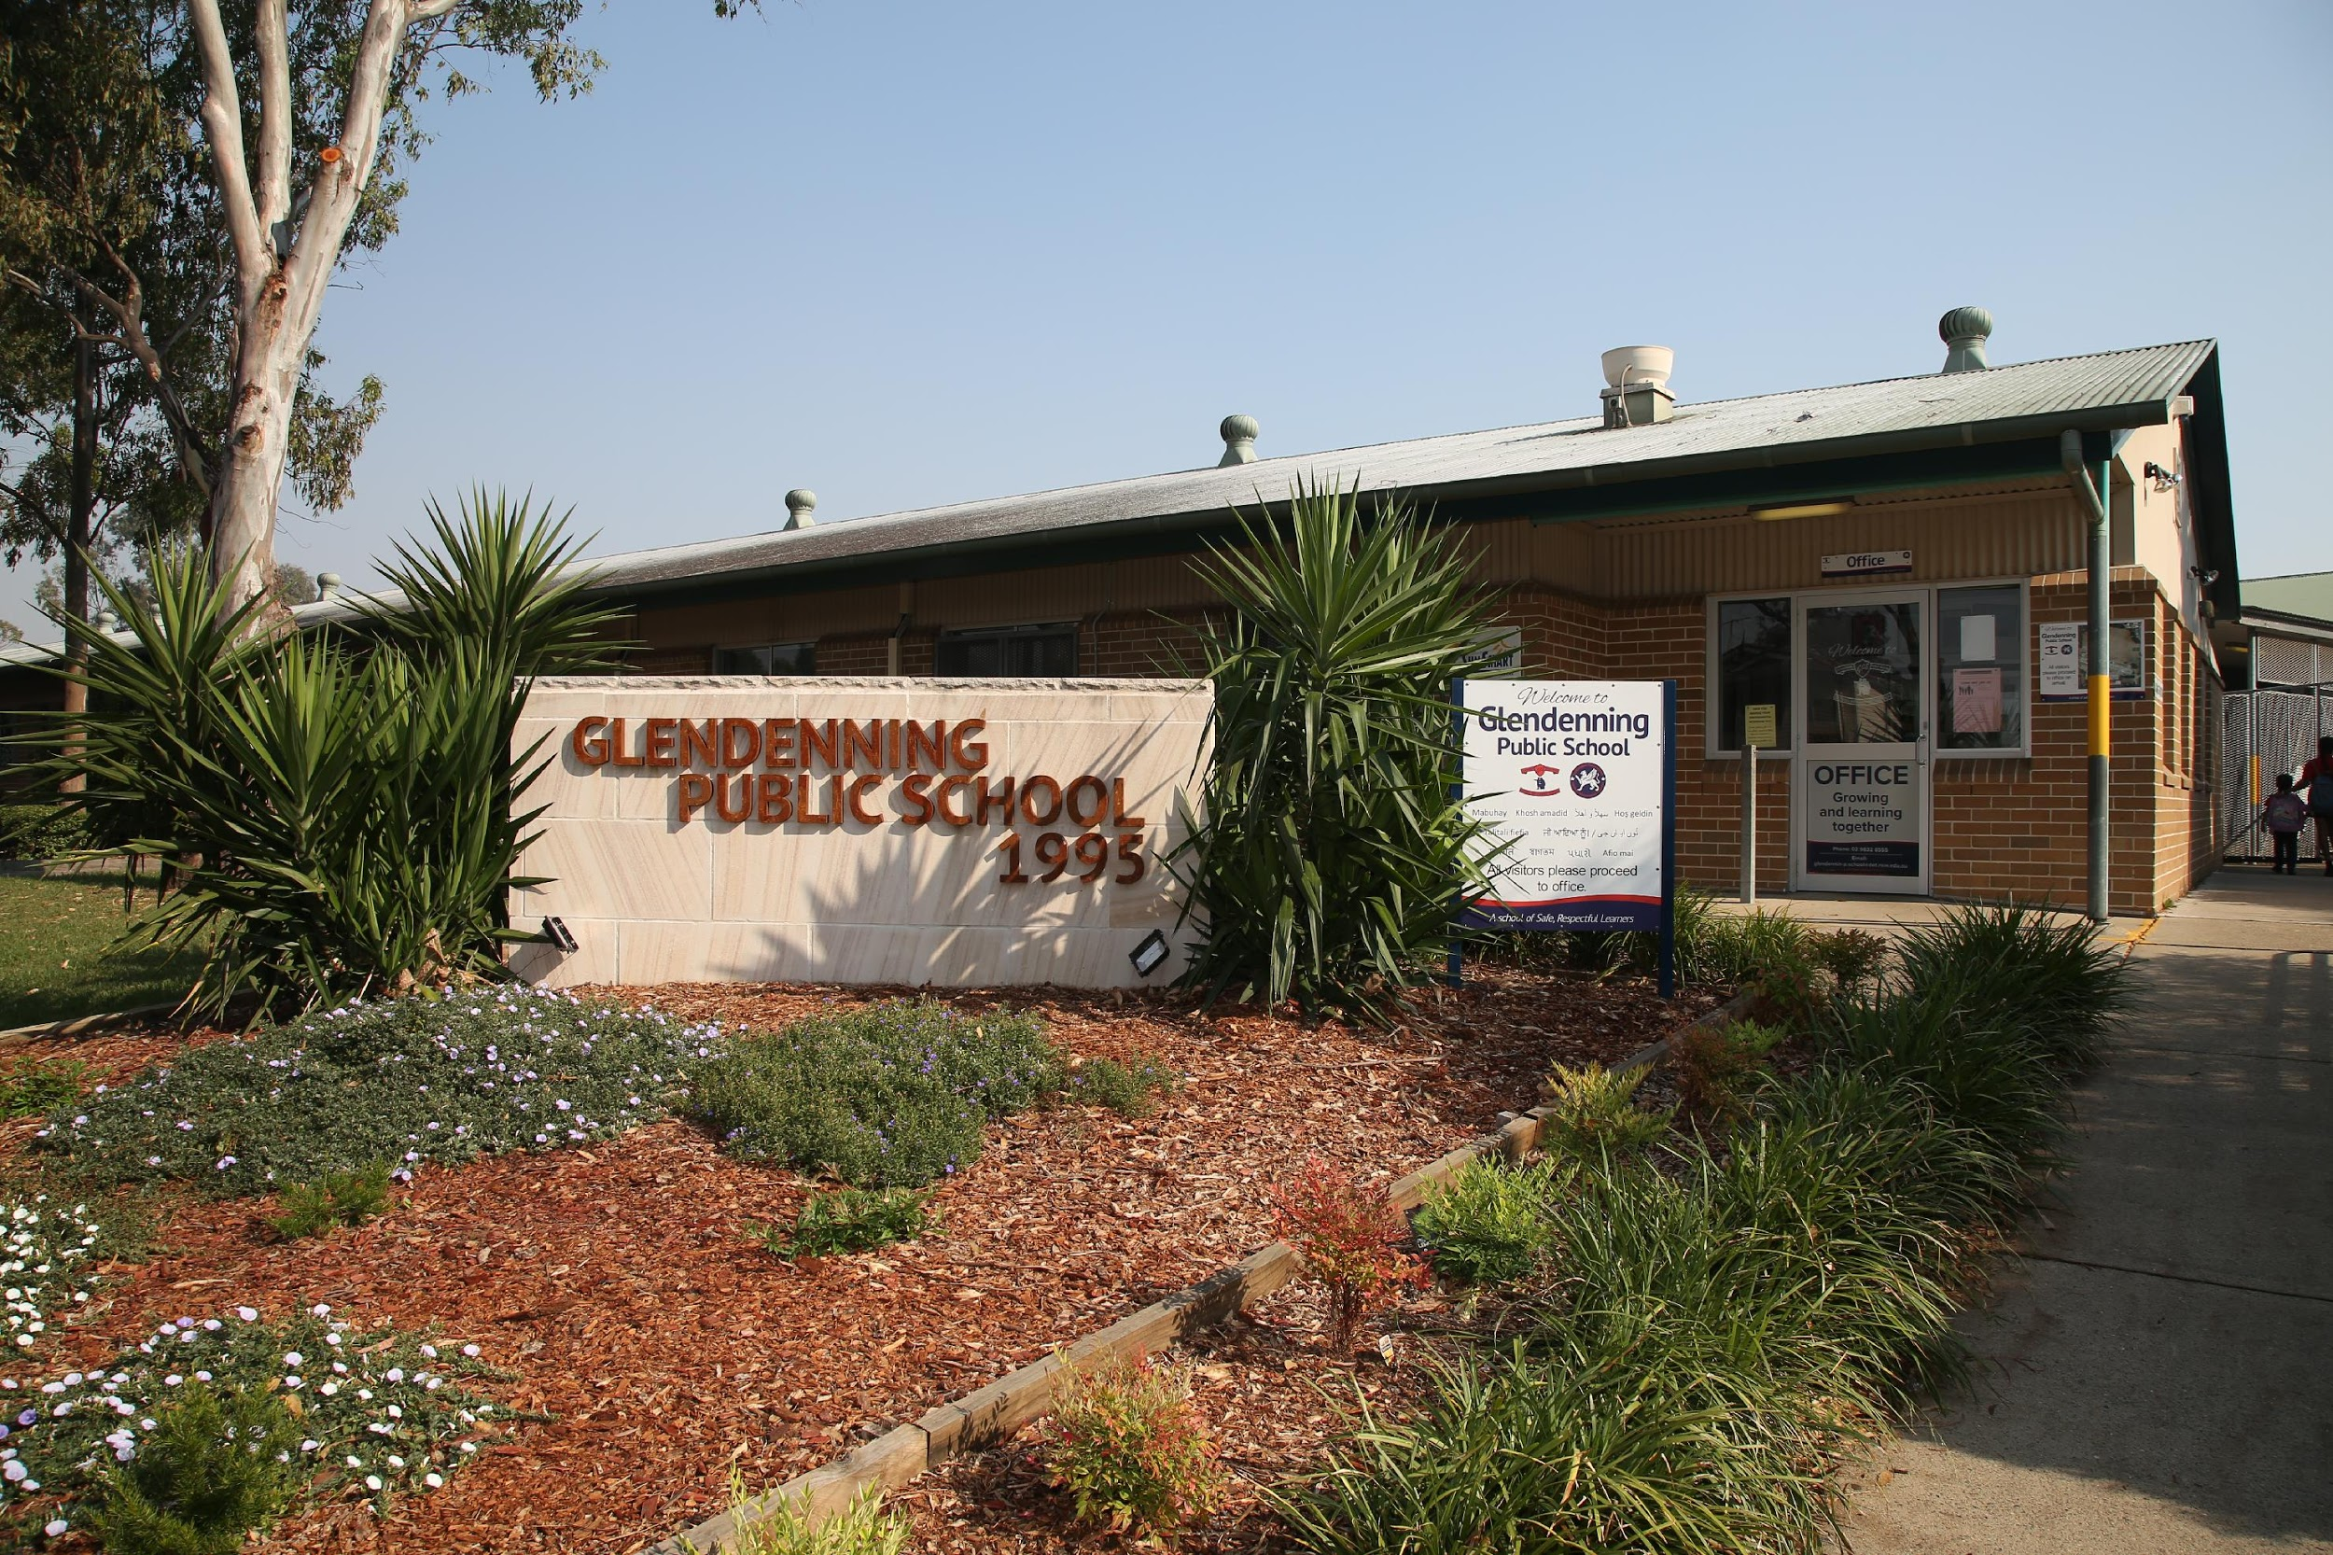
THANK YOU!
Please contact the office if you would like to speak to your child’s classroom teacher:
9832 8555 or via the school email address.
Notes:
tamiko

